Slide 1
Experiential Learning
Online
Pat Maher
Dean of Teaching

Slide 2
Presentation Outline
Intro to me
Experiential Learning
Under usual circumstances
Online?
A few examples
Concluding Thoughts
Acknowledgements

Slide 3
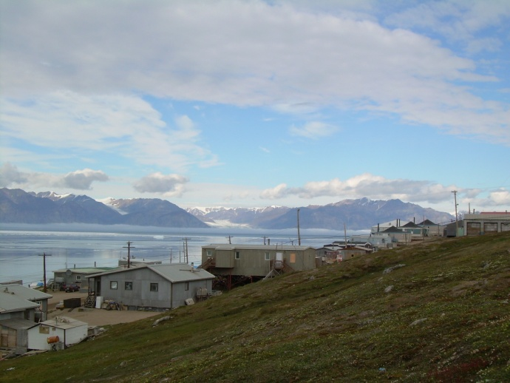
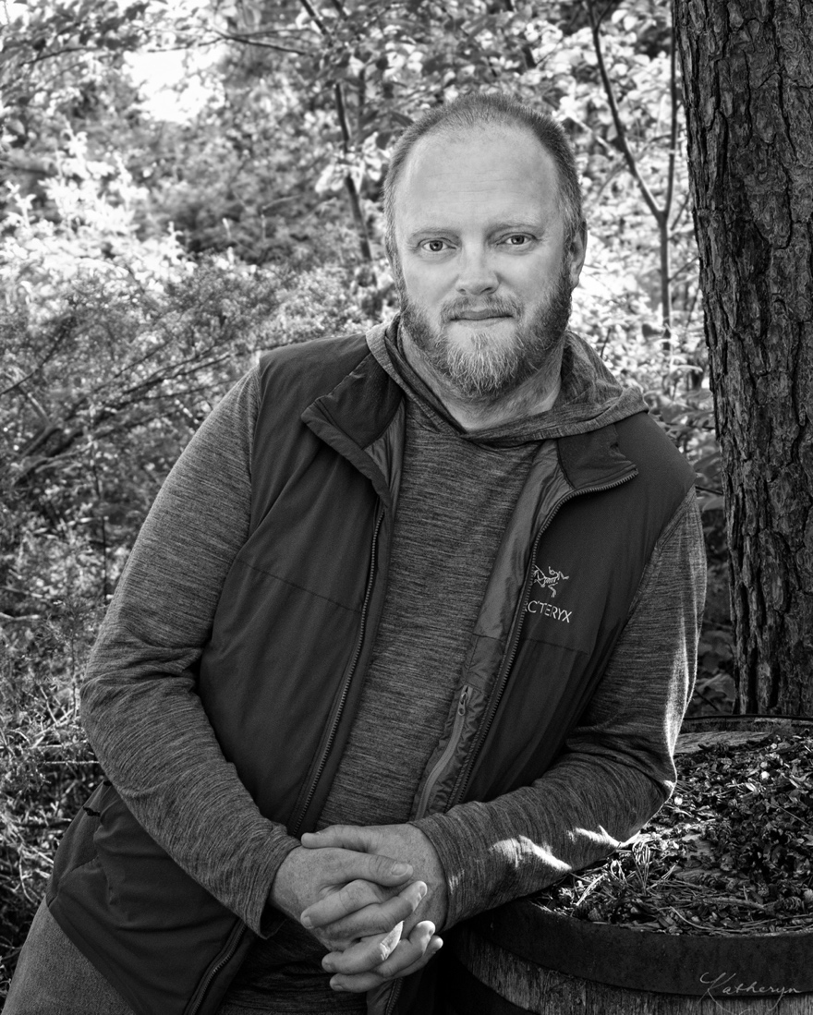
Full Professor, Physical and Health Education
PhD, Tourism and Environmental Studies (Lincoln University, NZ)
3M National Teaching Fellow (2014)
Chair, Council of 3M National Fellows for Teaching and Learning in Higher Education
Associate Editor, Canadian Journal for the Scholarship of Teaching and Learning
Formerly:
Editor, Journal of Experiential Education
Teaching Chair in Community Engaged Teaching and Scholarship
Online instructor since 2004

Slide 4
Also: Father of 2 boys, Husband, Skier, Paddler, Dog musher, LEGO enthusiast…

Slide 5
Experiential Learning

Slide 6
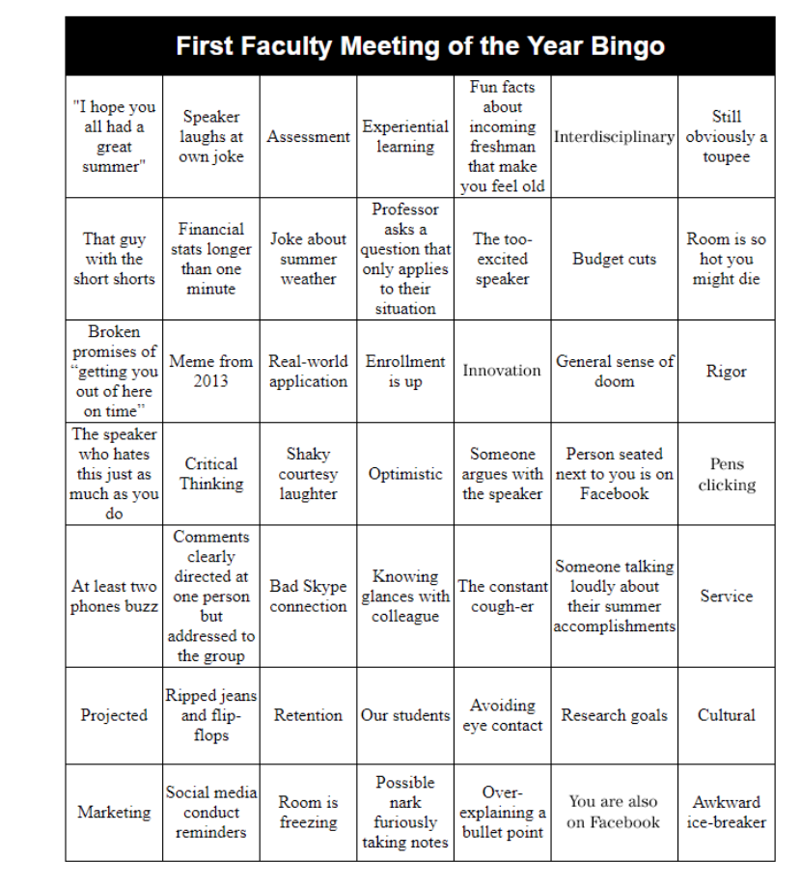
Under Usual Circumstances

Slide 7
A lot of Terminology:
Outdoor Education
Place-based Education
Service Learning
Active Learning
Transformative Learning
Self-Directed Learning
Problem-Based Learning
Hands-on Learning
EVEN LEARNING VS. EDUCATION

Slide 8
Described as:
Direct experience
Learning by doing
Learning by doing with reflection
Method vs. philosophy

Slide 9
Experiential Learning Cycle (Kolb, 1984; 2014)
Concrete
Experience
Application
Reflection
Generalization

Slide 10
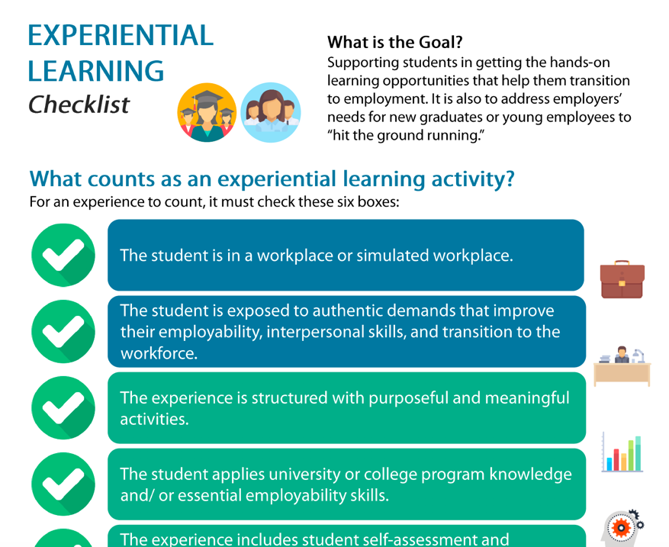
Government Definitions

Slide 11
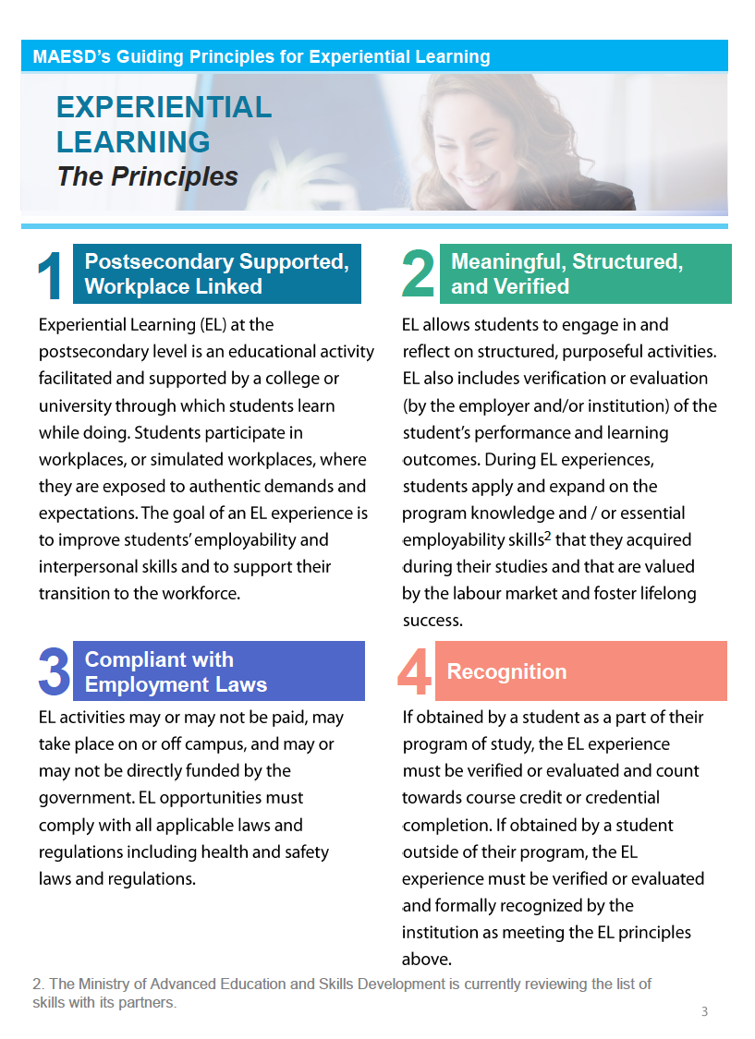
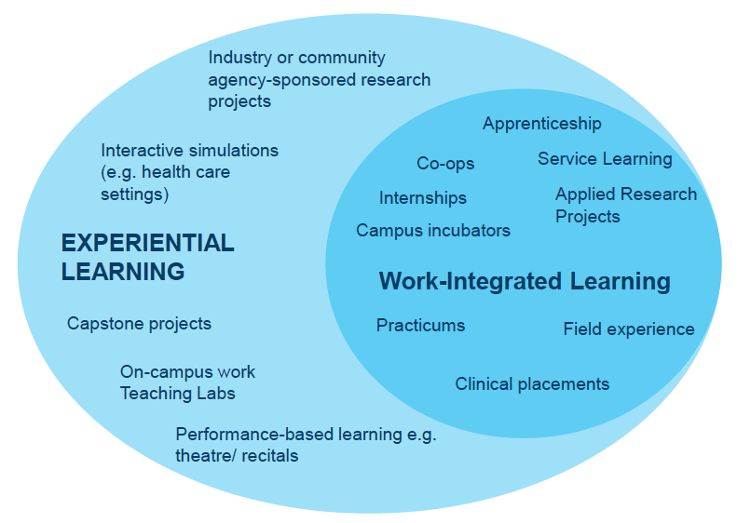

Slide 12
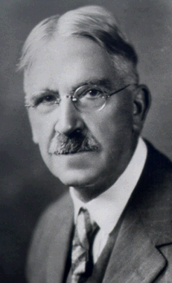
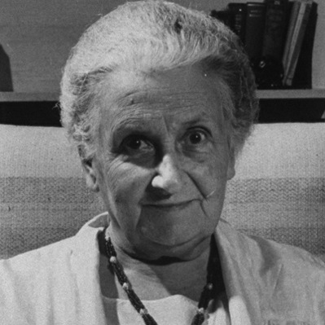
A bit of history
Progressive education movement as an alternative to ‘traditional’ Western approaches to education (starting in late 1800’s).
Western EE has been largely based on John Dewey & in the outdoors, Kurt Hahn.
Remember Maria Montessori too
Whole child, phases of development, child driven-inquiry.
Decentering teachers as keepers of an environment geared for children.

Slide 13
Dewey noted that:
Not all experiences are educative: Some are mis-educative. Some are aimless activity.
Experience needs to be (1) relatively enjoyable and (2) open doors to life-long learning.
Learning is student-centered (engaging their needs and interests) and community-connected (occurring in the ‘real world,’ of which students are citizens).
Not just “learning by doing” but a carefully planned and guided pedagogical process, which often involves disseminating information.
Education should not be a disciplinary process for a future life, but one of engagement and participation in life for a vital democracy.

Slide 14
Online?
Everything can happen the same – just think outside the box
Remote distribution of experience
Different ways to reflect
Different ways to assess
Snow, K., Wardley, L., Carter, L., & Maher, P.T. (2019). Lived Experiences of Online and Experiential Learning in Four Undergraduate Professional Programs. Collected Essays on Learning and Teaching, 12, 79-93.

Slide 15
A Few Examples

Slide 16
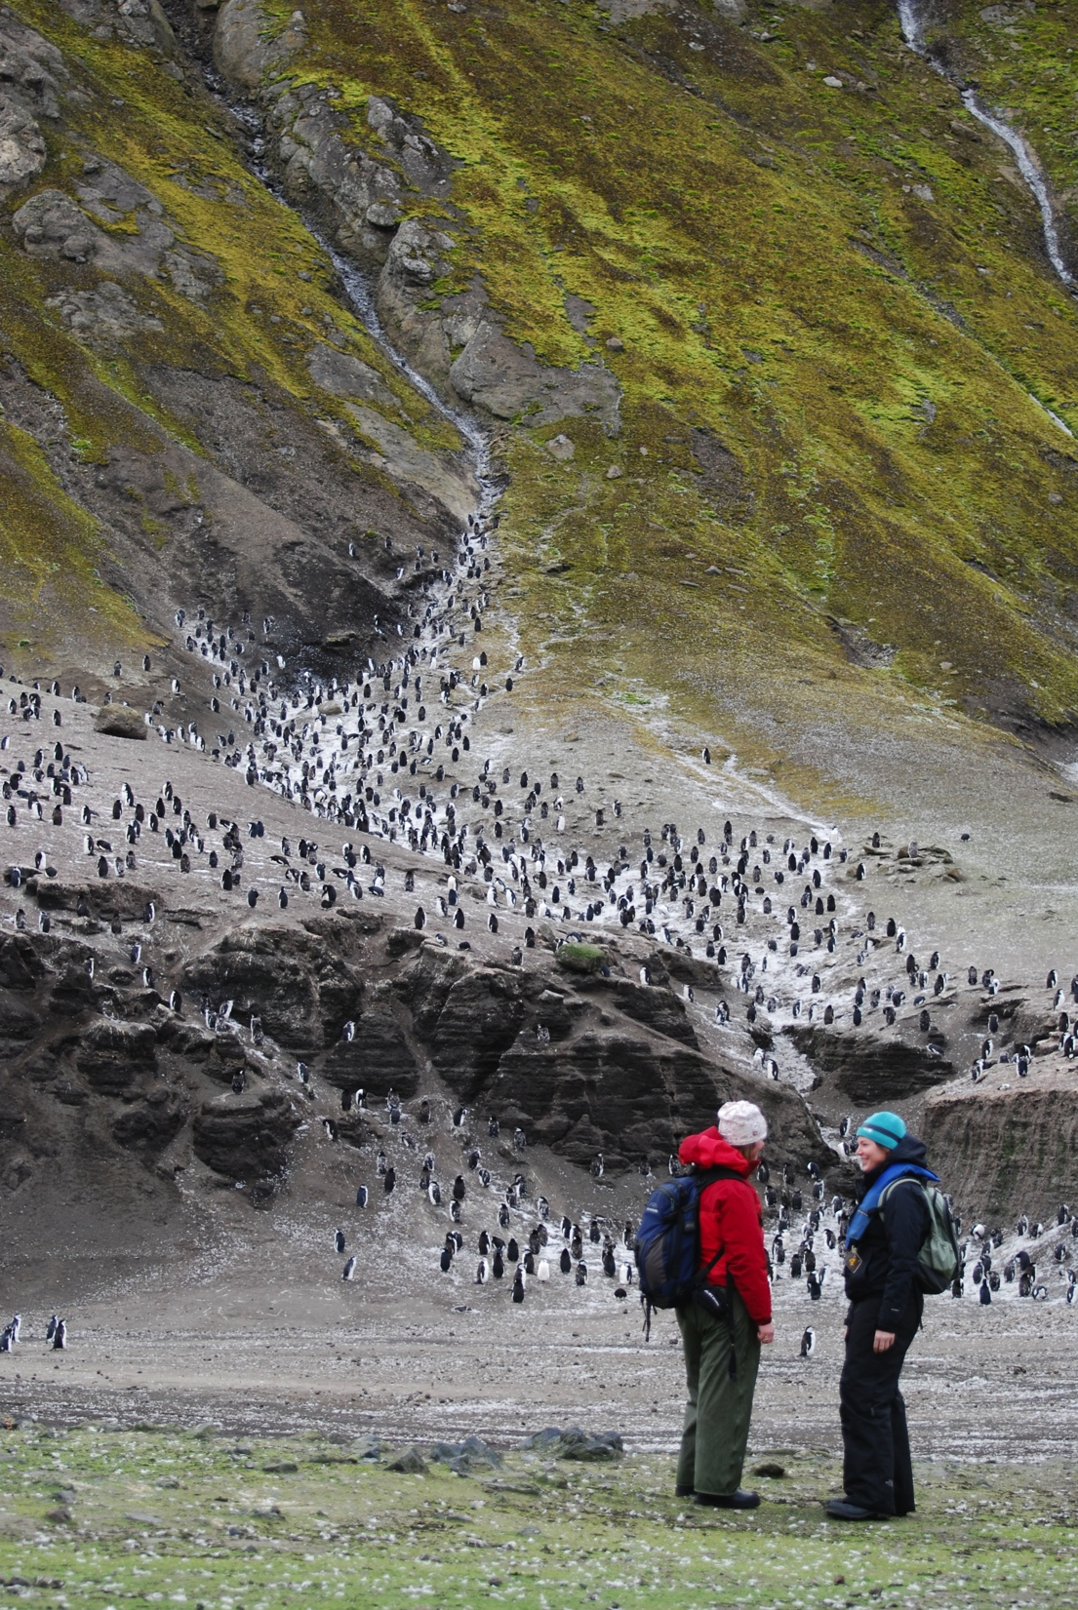
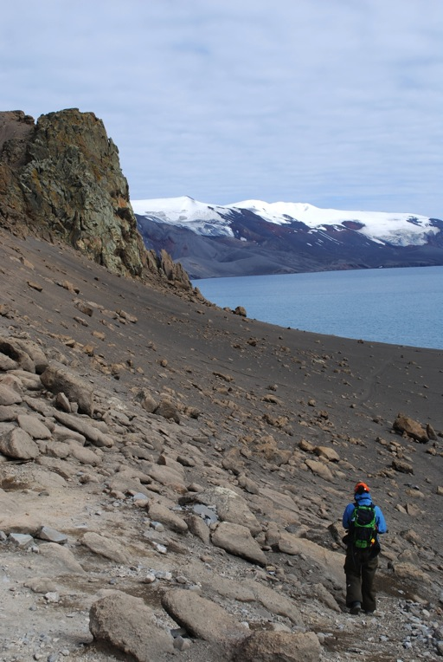

Slide 17
Online Field Trips

Slide 18
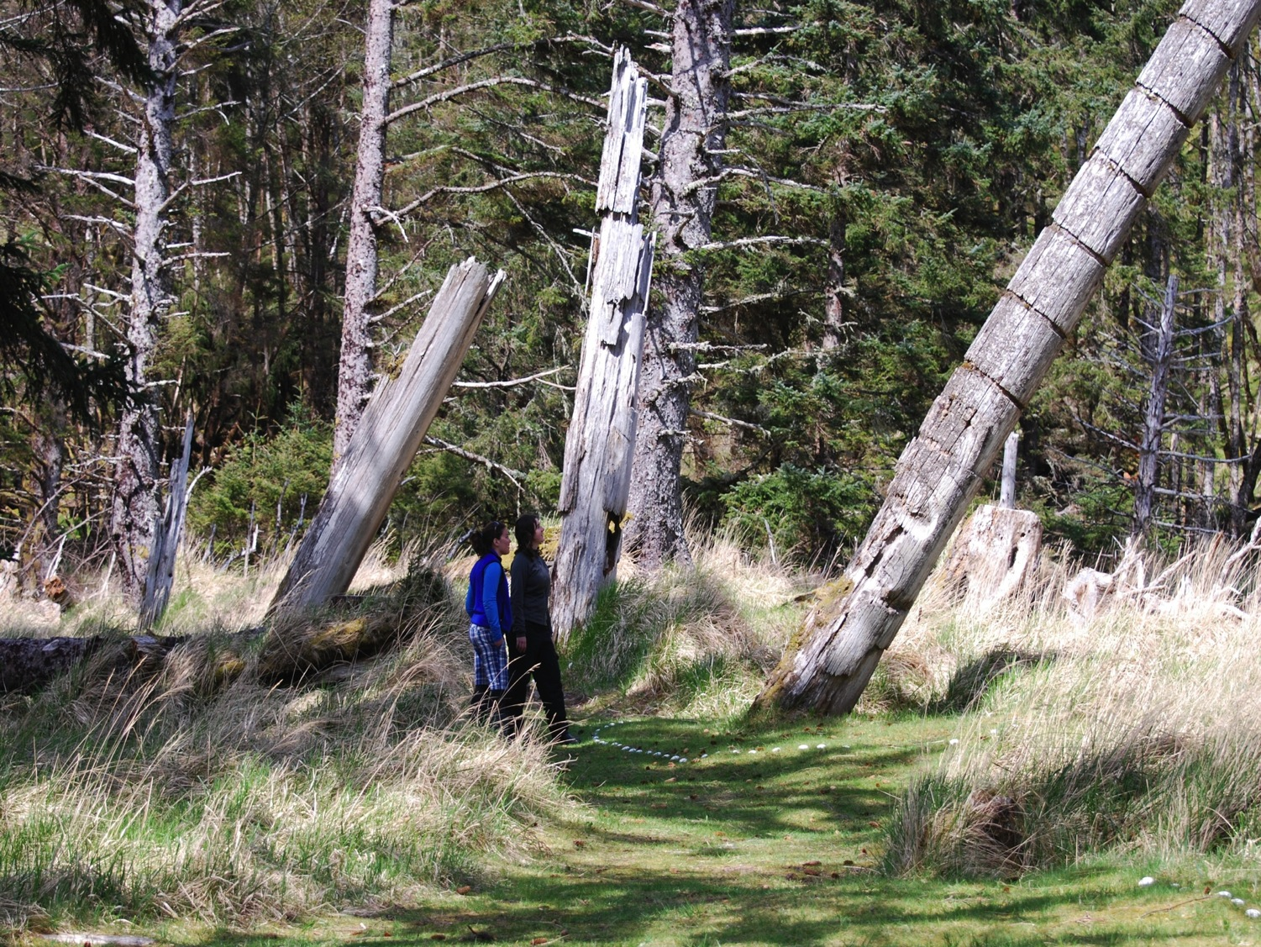

Slide 19
Online Service Learning/ Work-Integrated Learning

Slide 20
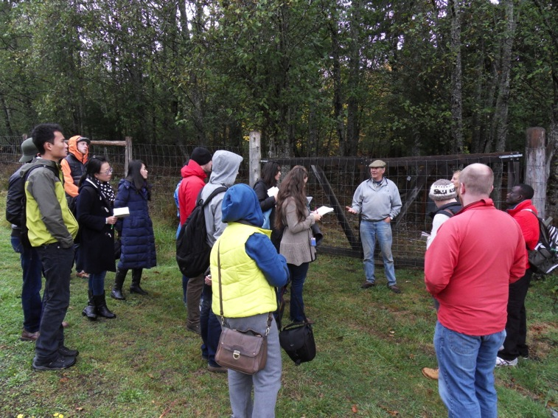

Slide 21
Online Speakers/Industry Engagement

Slide 22
Concluding Thoughts
Think about the opportunities, not the constraints
Loads of possibilities
Loads of resources and supports

Slide 23
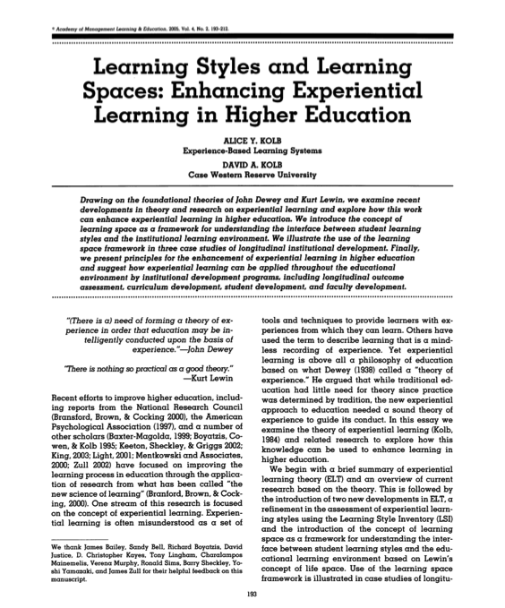
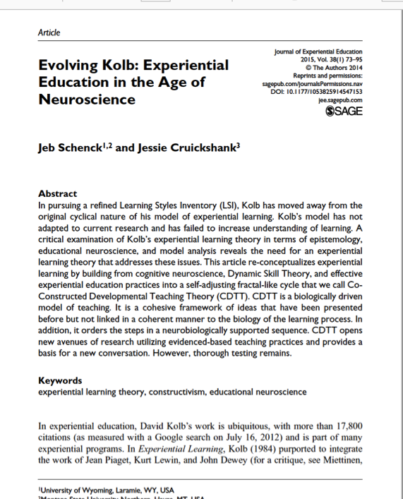
Learning Styles and Learning Spaces: Enhancing Experiential Learning in Higher Education
Alice Y. Kolb and David A. Kolb (2005). Academy of Management Learning and Education, 4(2), 193-212.
Evolving Kolb: Experiential education in the age of neuroscience
Jeb Schenck and Jessie Cruickshank (2015). Journal of Experiential Education, 38(1), 73-95.

Slide 25
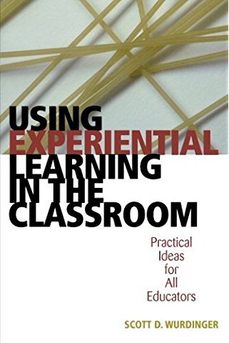
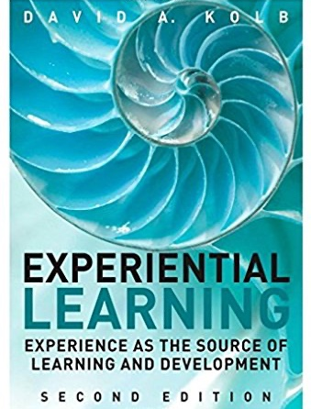

Slide 26
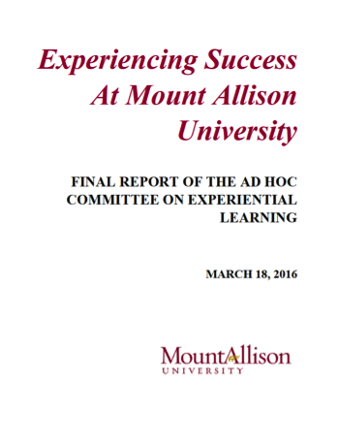
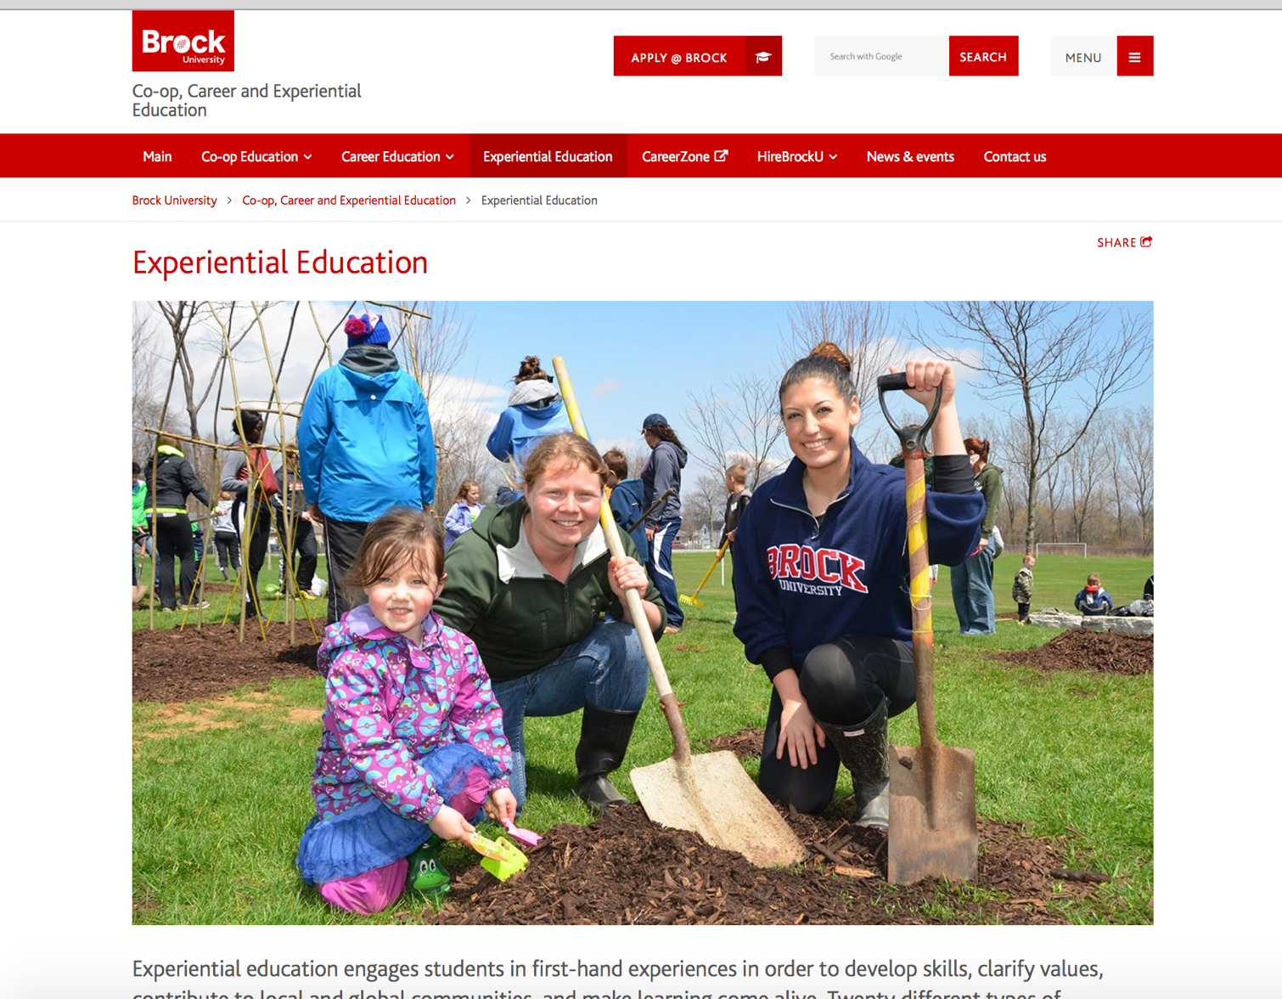

Slide 27
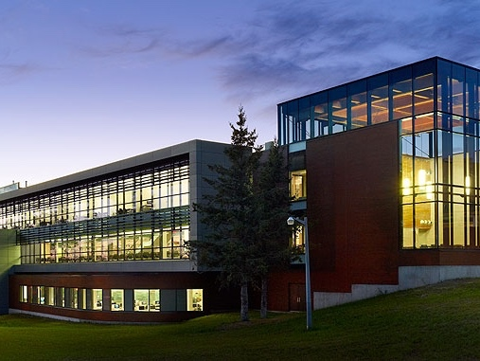
Thank you | Any Questions
@DrPatMaher patmaher@nipissingu.ca

