Slide 1
Schulich School of Education – CLE 2019 Costa Rica
Application Instructions
myinternational.nipissingu.ca

Slide 2
Bill Steer and Jeff Scott Google: Back Roads Bill CBC

Slide 3
Costa Rica – Nipissing University – Bachelor of Education 18 Students Community Placement EDUC 4858 Overview “Pura Vida” – Everything good” CLE

Slide 4
Looking to make a difference in others and yourself? Wanted, 18, flexible, B.Ed. students..

Slide 5
************************************************************************************* * A personal time commitment will be required, as a team to develop fun games and activities.

Slide 6
Suitcase
And the suitcase…with items for donation to schools and others in the community. (School supplies, clothes, shoes etc…)

Slide 7
Location: Sarchi, Costa Rica, (NW of San Jose in the highlands/central valley – between Naranjo and Grecia). Sarchi is a small town.

Slide 9
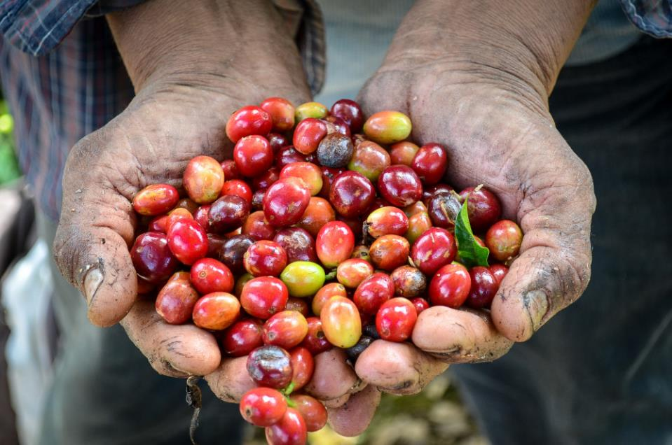

Slide 10
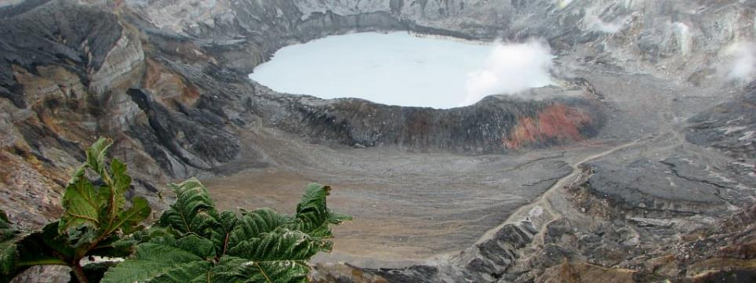

Slide 11
Arenal

Slide 12
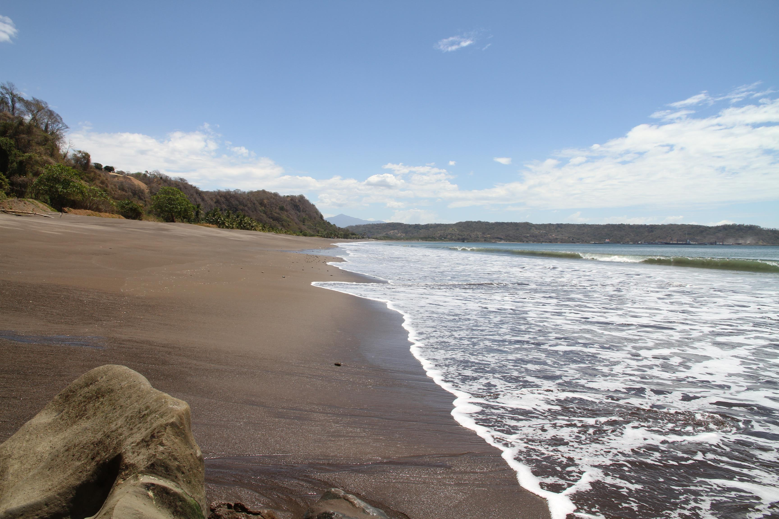

Slide 28
Costa Rican teacher contact for the schools, Mauricio Perez. The accommodation is a “home stay” for all of us together, (Patricia Salzar).

Slide 33
Most likely departing from Toronto on Saturday or Sunday, February 23/24 and returning Tuesday, March 11-13th, 2019

Slide 34
CLE - Community
Seniors residence
*Drug Rehab. farm
Recycling centre
*Sustainable Farm
PD for teachers - sessions
English help – school visits
Donations –families and others

Slide 35
Fun!
Art at night
Soccer – game
Jewellery making
Community walkabout
Two weekends

Slide 36
Needed • Towels, toiletries and personal belongings (good walking shoes).

Slide 37
• Transportation on Weekend One – Arenal – one night)

Slide 38
• Transportation to coast – Weekend Two Friday night or Saturday departure and travel to the coast – two nights

Slide 39
The entire trip includes all ground transportation, all meals and accommodation and the two night stay on the NW coast to Playa Flamingo and one night in Arenal. (Zip line and surfing are your own fees.) *There will be an extra gratuity collected $20 USD for the education contact and a $10 USD for the home stay/van drivers. And a waterfall fee $10 USD. Budget $50 USD ($65 CDN) for extras to be collected. This is not within the overall fee paid to the University.

Slide 40
Approximately, $2300 (+-) Canadian (as soon as we book the flights) – plus the above gratuity (USD); + your own spending money.

Slide 41
“Costa Rica was the most eye-opening adventure I’ve ever had the pleasure of experiencing. Being given the opportunity to see the inner-workings of less fortunate schools in another corner of the world is something that will forever mold my way of teaching.
I believe everyone would agree that the best part of the trip was being able to donate so many items, not only to the schools, but to families who struggle daily just to feed their children.” Blair Wooley.

Slide 42
myinternational.nipissingu.ca
Use WebAdvisor Log In

